Slide 1
CARELInk 360 (Group 15)

Slide 2

Problem Statement

Slide 3
Healthcare, insurance, government and NGO operations work in disconnected systems, causing delays in treatment, approvals and fund allocation.
Patients repeatedly submit medical and financial information across multiple agencies, leading to redundancy, errors and slow decision making.
Public health officials lack real-time visibility into incident trends, blood needs and resource utilization.
There is no unified workflow platform that connects all stakeholders to coordinate patient care, financial processing and community support.
CareLink360 aims to solve these challenges by integrating all participants into a single, secure and workflow-driven ecosystem.

Slide 4
UML Diagram

Slide 6

Brief Advanced Feature Introduction

Slide 7
Advanced Features Implemented
Role-based Dynamic Work Areas Each user sees a customized dashboard generated by their Role class, ensuring correct permissions and guided workflows.
Cross-Enterprise Workflow Routing WorkRequests automatically move between organizations such as doctors, labs, blood banks, government officers, NGOs and insurance teams.
Automated Data Population Support System supports directory-based initialization for patients, insurance policies and customer-insurance data to reduce manual setup time.

Slide 8
High-level Component Diagram

Slide 9
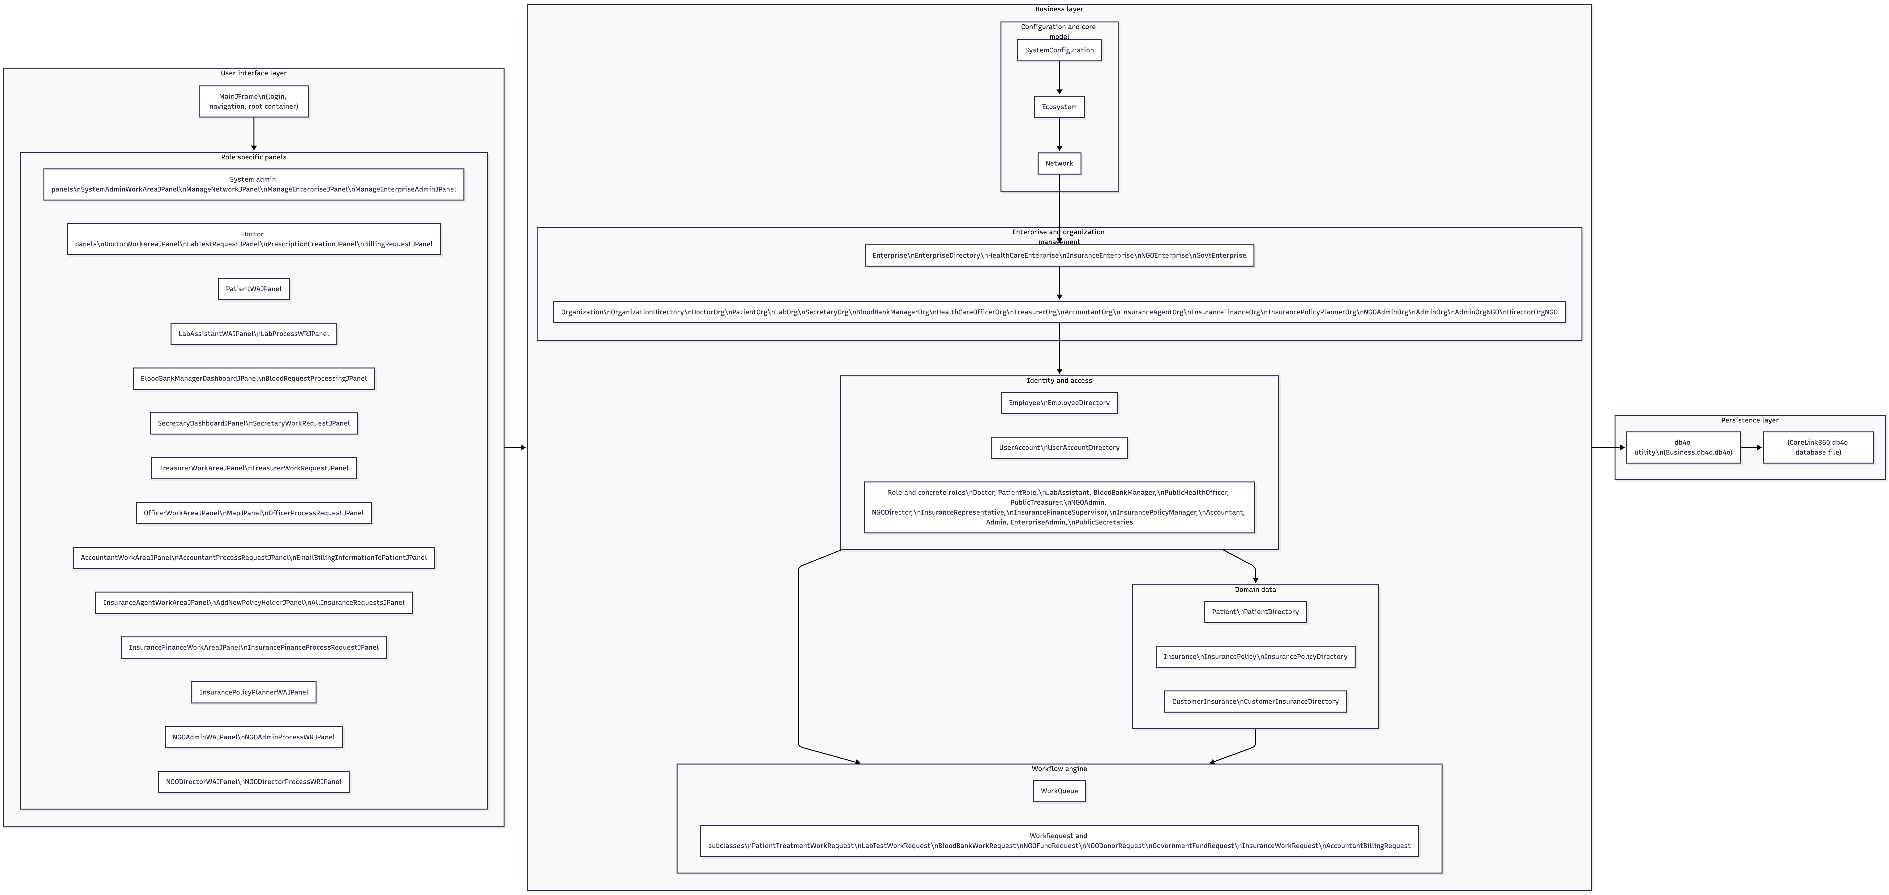

Slide 10
Thank you!
- Gagana Ananda
- Mallesh Mallikarjuna
- Jayanth Muthaluri
- Syed Hameed Uddin

